Slide 1
Advaced Analytics with TIBCO Spotfire
Spotfire Architecture

Slide 2
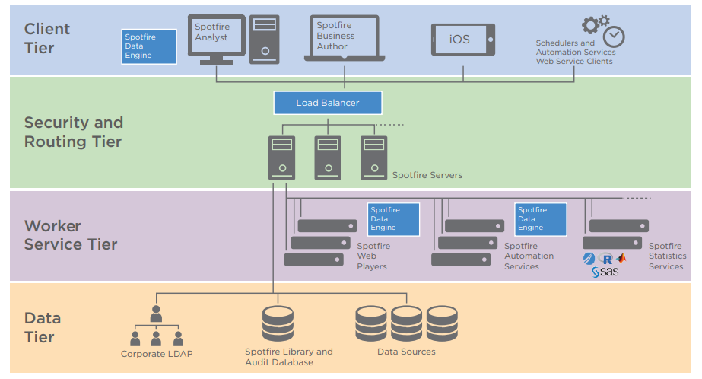
Spotfire Architecture

Slide 3
Spotfire Server
Tomcat web application running on Windows/Linux.
Enables users (through clients) to access their data, create visualizations and share them.

Slide 4
Spotfire Server – Main Functions
Authentication/authorization.
Provides access to analyses and data stored in the Spotfire library.

Slide 5
Spotfire Server – Main Functions
Provides access to external data sources, including Oracle and SQL Server databases, or most JDBC sources, through information links.
Makes sure that analyses are loaded with updated data according to schedules that are defined by the administrator.

Slide 6
Spotfire Server – Main Functions
Provides storage (in the Spotfire database) for configurations, preferences, analyses, and so on.
Manages the traffic through the Spotfire environment to optimize performance, and in accordance with rules that are defined by the administrator.

Slide 7
Spotfire Server – Main Functions
Distributes software updates throughout the implementation.
Monitors the health and activities of the Spotfire environment and provides diagnostic information both in the server interface and through downloadable logs.

Slide 8
Spotfire Database
Spotfire Server requires a dedicated database.
This database stores information regarding users, groups, licenses, preferences, shared analysis and system configuration data.
Before installing Spotfire Server, one requires a dedicated database. This can be an Oracle Database or MS SQL Server.

Slide 9
Spotfire Library
The Spotfire Library stores:
Spotfire analyses
Spotfire data files
Custom Spotfire data functions
Information links
Shared connections created with Spotfire connectors
Visualization color schemes.

Slide 10
Nodes and Services
For each node, the administrator enables Spotfire Web Player services, Automation Services, or both.
Spotfire Web Player service is used to analyze in a web browser.
Automation Services can be used to automate creation of analysis files, for example, with new data. Multiple service instances can be added on each node.

Slide 11
Scalability
You can scale your Spotfire environment by adding or removing nodes and service instances almost without limits.
Multiple instances of multiple client requests can be routed through multiple Spotfire servers, which in turn route traffic to backend worker nodes.

Slide 12
Scalability
Each worker provides services such as Spotfire Web Player, Spotfire Automation Services, or Spotfire Statistics Services.
This is achieved through smart routing and node managers.

Slide 13
Node Managers
Node managers manage one or more services running on the same server (a node). This enables:
Lifecycle management starting, stopping
Centralized deployment and configuration management
Centralized logging and monitoring

Slide 14
Node Managers
Benefits
Limit resource utilization by routing users to an already open analysis file.
Isolate files by geography/business unit/security.
Support for rolling upgrades.
Load an analysis on multiple service instances to handle concurrent users.

Slide 15
Spotfire Client Applications
Desktop
Spotfire Analyst: on-premises Spotfire server
Spotfire Cloud Analyst: connects to cloud-based instance.
macOS: wrapper around Spotfire web clients
Web
Spotfire Consumer: read-only web client.
Spotfire Business Author: Some authoring capabilities, like loading data and editing visualizations.
Mobile
Consumer-type client for iOS and Android.

Slide 16
Spotfire Automation Services
Update and distribute reports on a time schedule, for example:
Opening a quarterly sales dashboard, updating the data, saving a snapshot copy to the Spotfire Library, and emailing a DXP file as an attachment to each sales rep so they can view the data offline.

Slide 17
Spotfire Automation Services
Repeating the above use case but using parameters to create different DXP files.
Performing the migration of an analysis file between the Test and Prod Spotfire environments, automatically updating the database connection information.
Custom tasks can also be developed using the Spotfire SDK.

Slide 18
Statistics Services
A lightweight, flexible server that provides a communication layer, a service layer, and a TIBCO® Enterprise Runtime for R (TERR), S- PLUS, or open-source R engine pool.
SAS and MATLAB also supported.

Slide 19
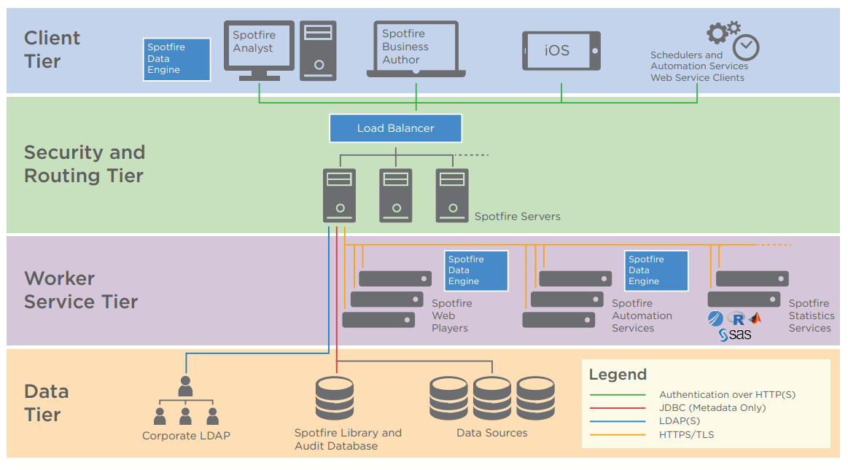
Environment Communication

Slide 20
Environment Communication
After an administrator has approved the new server or node, the certificates are issued automatically.
Without a certificate, a server or a service on a node cannot make requests to, or receive requests from, other entities, except for when requesting a certificate.
After being installed, a node performs a join request to a specific, unencrypted HTTP Spotfire Server port that only handles registration requests.

Slide 21
Environment Communication
The node remains untrusted until the administrator approves the request by trusting the node.
The Spotfire Server start page provides the tools to add nodes to the environment by explicitly trusting them, thereby issuing the certificates.
When the node receives its certificate, it can send encrypted communication over the HTTPS/TLS ports, and with this it can start to send more than registration requests.

Slide 22
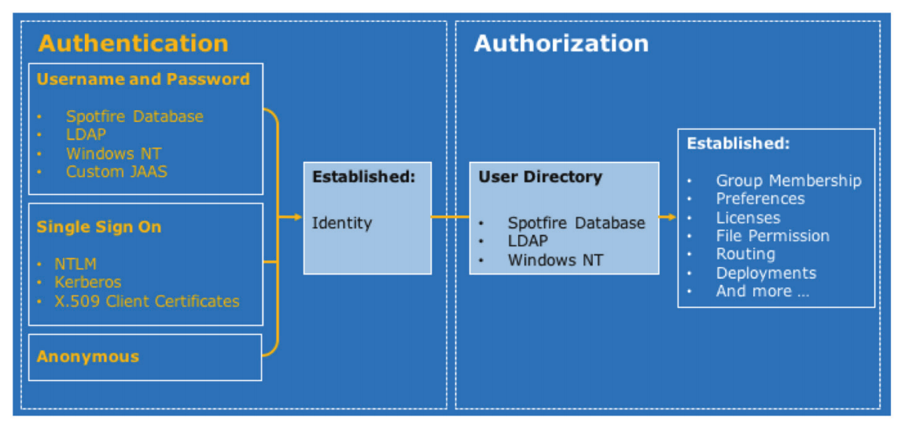
Authentication and Authorization

Slide 23
Deployment
To deploy Spotfire software, the administrator places software packages in a deployment area on Spotfire Server, and assigns the deployment area to particular groups.
Deployments are managed in the Spotfire Server web-based Admin Console.
If a new deployment is available when a user logs in to a Spotfire client, the software packages are downloaded from the Spotfire Server to the client.

Slide 24
Deployment
Deployments are used to:
Set up a new Spotfire environment.
Install a product upgrade, extension, or hotfix provided by Spotfire.
Install a custom tool or extension.
Administrators can create multiple deployment areas, such as “Production” and “Staging.” This allows administrators to test new deployments before rolling them out to the entire client base, or to maintain different deployments for different groups of users.

Slide 25
Load Balancing and Failover
A cluster of Spotfire Servers in an environment can be fronted by a load balancer to distribute the traffic to the servers. The load balancer should be able to detect if an instance becomes available or unavailable.
Any load balancing technology supporting session affinity may be used.

Slide 26
Load Balancing and Failover
No load balancer is required between Spotfire Server and the nodes because load balancing is built-in.
Non-opened analyses to be loaded by the least used Spotfire Web Player service instance.

Slide 27
Spotfire Web Player
Web Player shares parts of the analysis files and data between multiple users to make efficient use of resources.
Traditional load balancers will assign users to individual servers in turn (round-robin) or to the least used server.

Slide 28
Spotfire Web Player – Routing
Instead of allocating users to free servers and opening up multiple copies of the same report, Spotfire will open (and remember) a copy, and send further requests for that report to the same server.
Rules can be applied on file, user group, location, etc. and can be scheduled.
You need TIBCO Spotfire Node Manager installed.

Slide 29
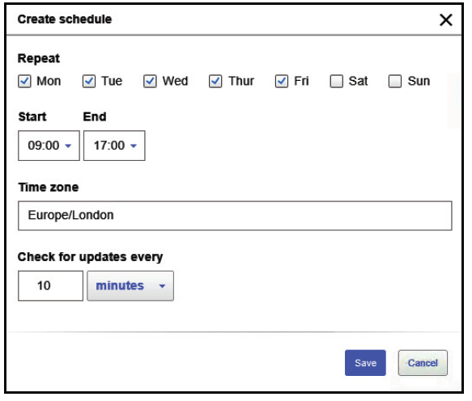
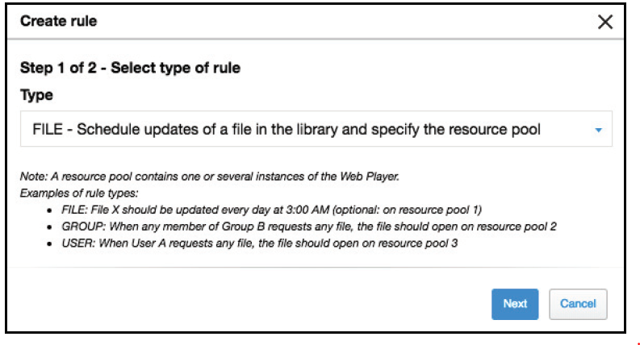
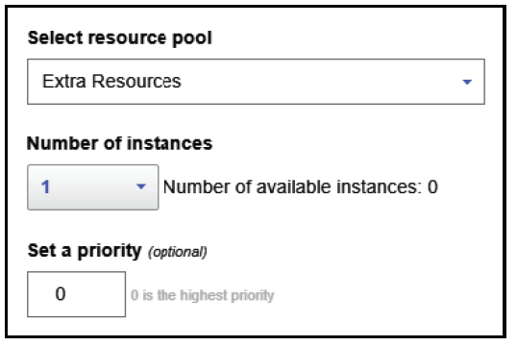
Example: Schedule file updates

